Slide 1
General
Collection info

Slide 2
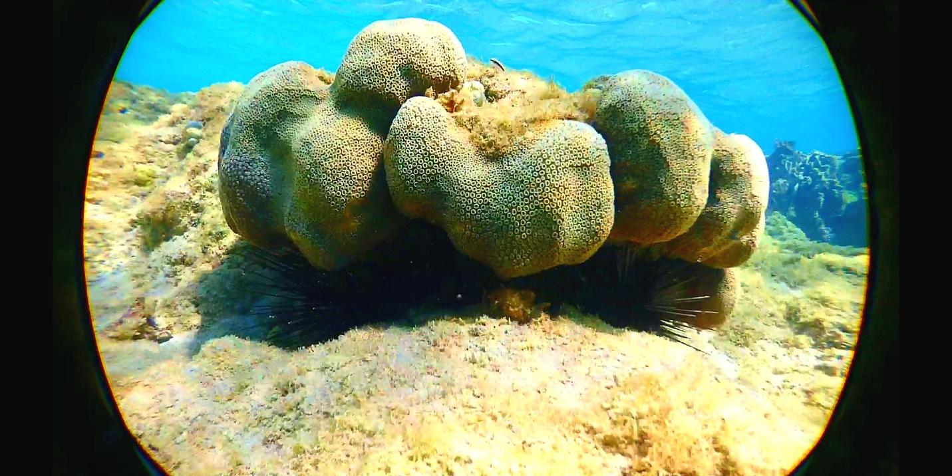

Slide 3
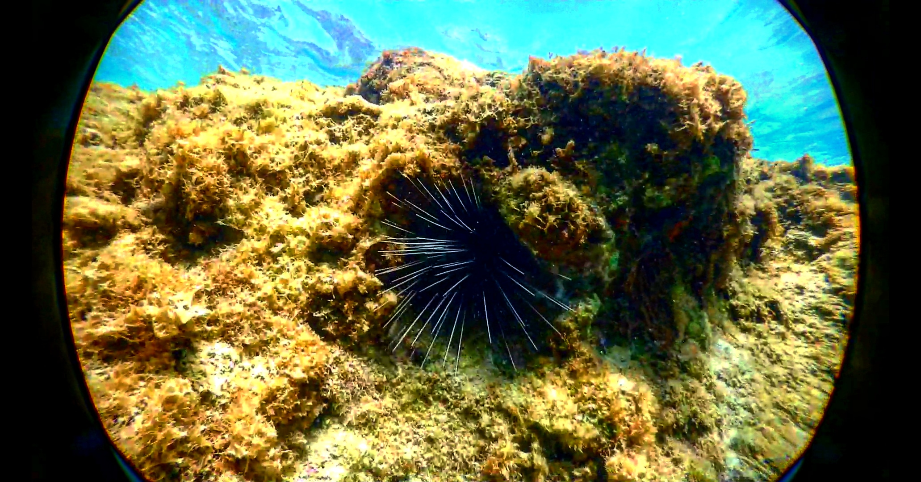

Slide 4
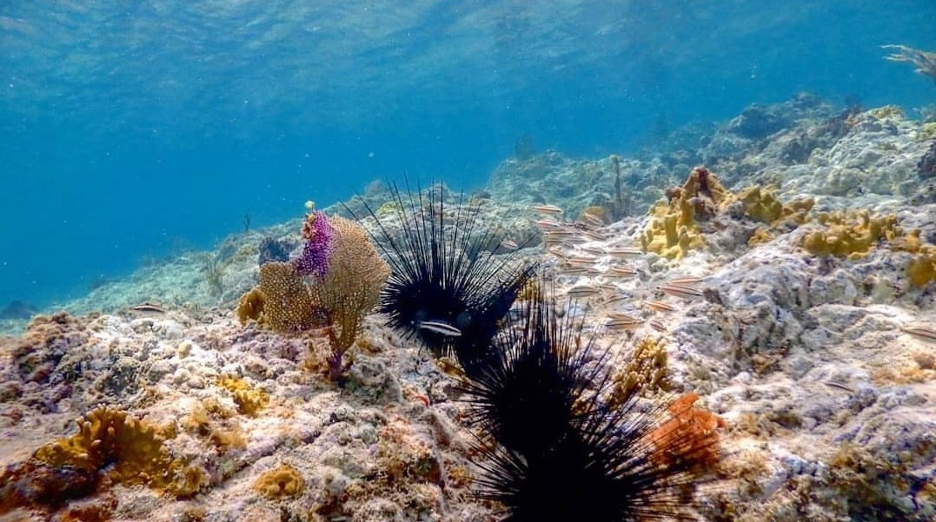

Slide 5
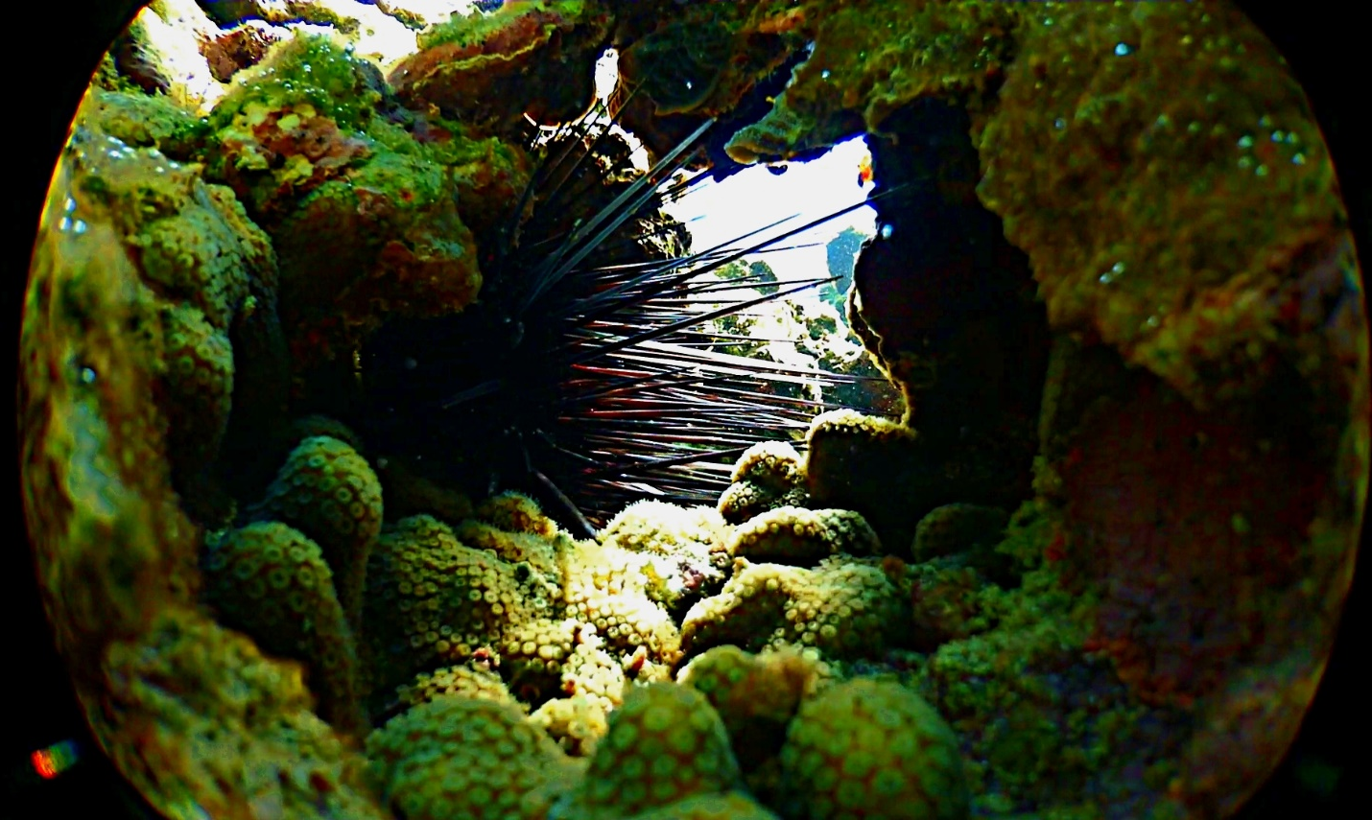

Slide 6
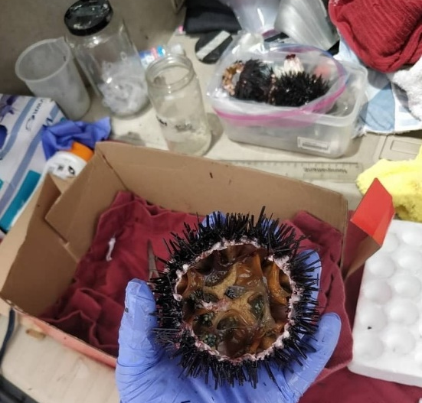
Notes:
Here is an image of the sea urchin tissue collection after the sea urchin is cut open to remove the gut tissue. In the back you can see a biohazard container with all the biological hazards to be transported and properly discarded.

Slide 7
Municipality | Coordinates | Depth (in feet) | Comment
Ceiba | 18°13'07.8"N 65°36'15.4"W | 1-4ft | Rocky Reef within 50ft of shoreline, coral was present. Thriving environment, coral reef was present, lots
Culebra | 18°18'08.8"N 65°18'33.8"W | 1-10ft | Rocky Reef within 50ft of shoreline, coral was present. Most diverse colony, some specimens were red, some had white tips, was mostly white, some sargasum at beach.
Guanica | 17°56'05.2"N 66°57'25.6"W | 4 – 5ft | Rocky shore. Little to no sargassum at beach, low visibility
Guayama | 17°55'51.3"N 66°09'41.0"W; 17°55'47.3"N 66°09'32.1"W | 1-10ft | Rocky Reef within 50ft of shoreline, coral was present. Close to a harbor, low visibility. High amount of algae and fish, other types of sea urchin present, medium turbidity.
Isabella | 18°30'56.8"N 67°06'00.6"W | 2ft-6ft | Rocky Reef within 50ft of shoreline, coral was present. Strong current and riptide, healthy specimens (full gut).
Luquillo | 18°23'15.3"N 65°43'10.6"W | 3 ft | Rocks surrounded by an algae bed, no coral. Urchin found in rock, rock found in big algae bed, healthy specimens (full gut).
Ponce | 17°57'50.5"N 66°36'35.9"W; 17°58'20.7"N 66°37'04.5"W; 17°57'54.5"N 66°36'28.1"W | 3 ft - 15ft | Rocks, little to no algae, no coral, within 50 ft of shore. Moderate levels of human trash, visibility good.
Rincon | 18°20'35.2"N 67°15'36.5"W | 4 ft to 15 ft | Rocky Reef within 50ft of shoreline, coral was present. Many boats coming in and out that caused a lot of debris (highly turbid waters). Low visibility (4 feet). Healthy Specimens.

Slide 8
 | 1.5 in | 2 in | 2.5 in | 3 in | 3.5 in | 4.5 in
Rincon | - | 1 | 2 | 4 | - | -
Ponce | - | 1 | - | 3 | - | -
Luquillo | - | - | 3 | 1 | - | -
Isabela | 1 | - | 1 | 2 | - | 1
Guayama | 1 | 1 | 1 | - | - | -
Guanica | 1 | 1 | - | 1 | - | -
Culebra | - | 1 | - | 4 | 2 | -
Ceiba | - | 2 | 4 | 1 | - | -

Slide 10
Notes:
Generate a frequency distribution by size classes in histogram.

Slide 12
Notes:
Small (1.5+2in) Medium (2.5+3in) Large (3.5++)

Slide 13
16S

Slide 14
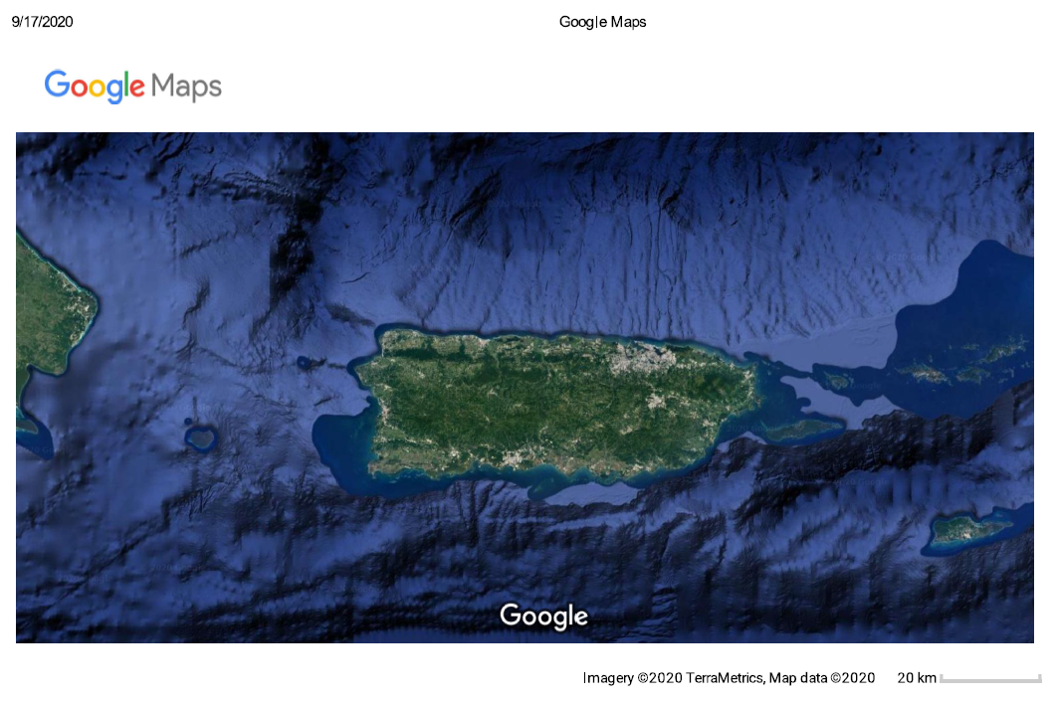


Slide 15
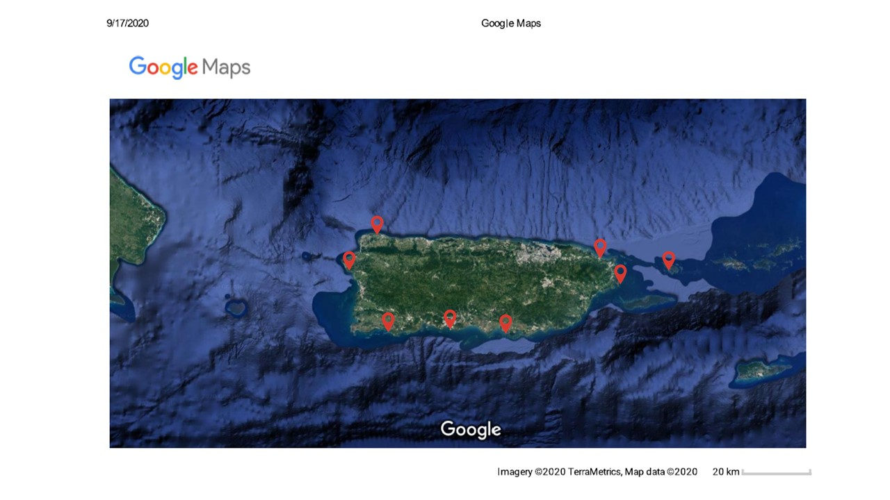

Slide 16
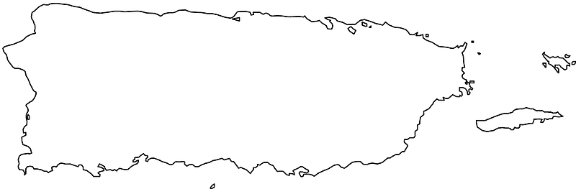
Notes:
Add labels to sea and land.

Slide 17
Notes:
Taxonomy by location level 4

Slide 18
Notes:
Taxonomy by location level 5

Slide 19
Notes:
Taxonomy by location level 6

Slide 20
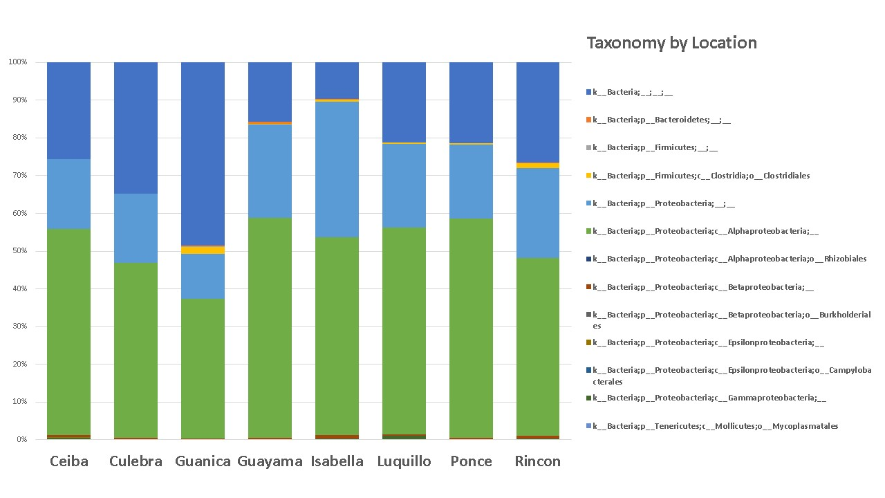

Slide 21
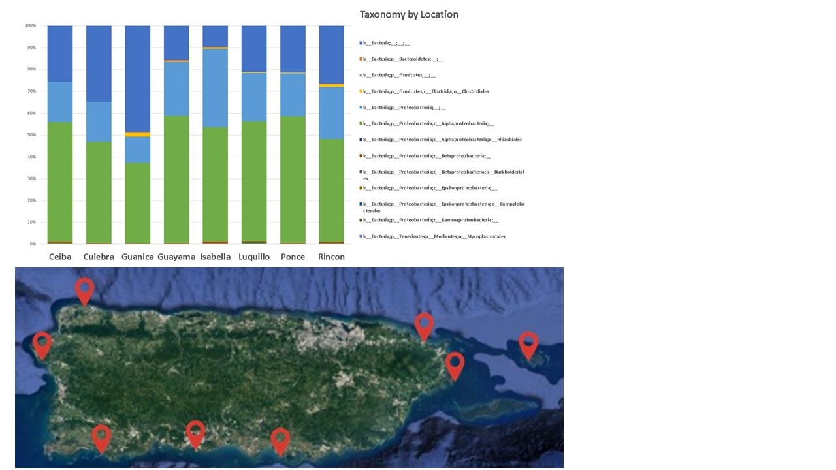

Slide 22
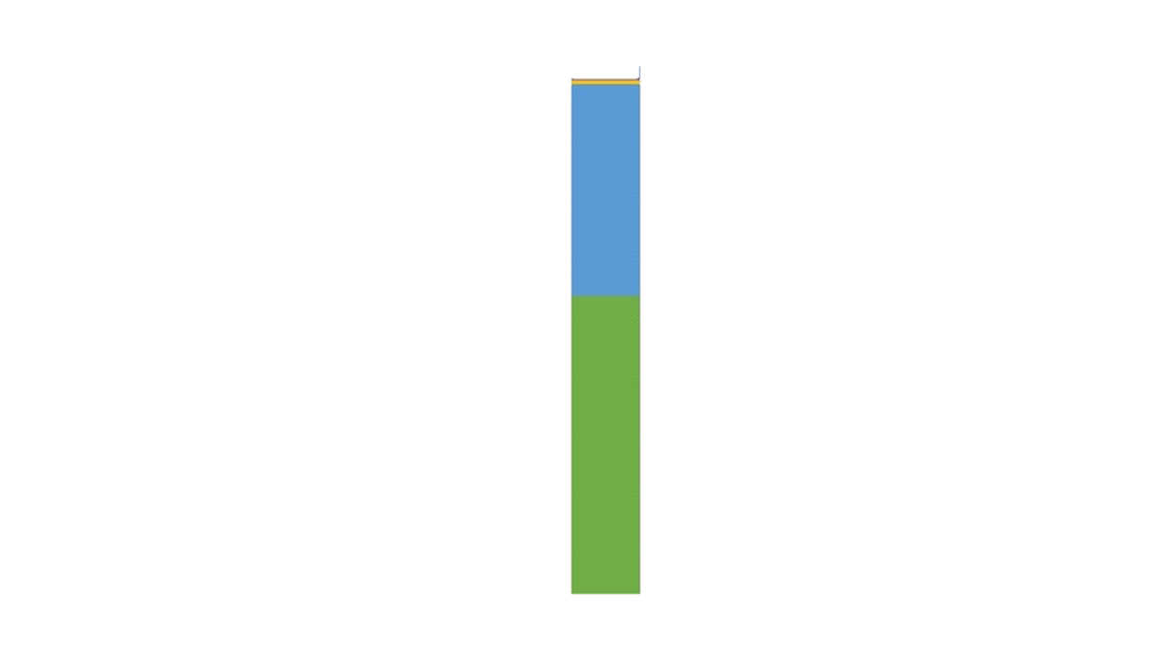









Slide 23
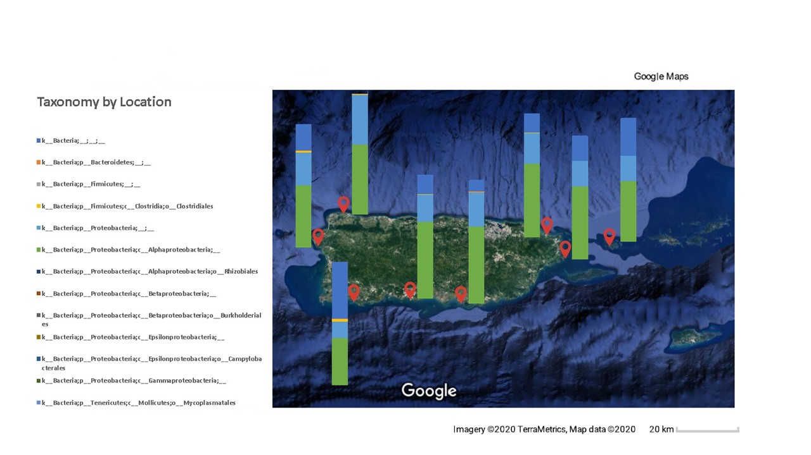

Slide 24
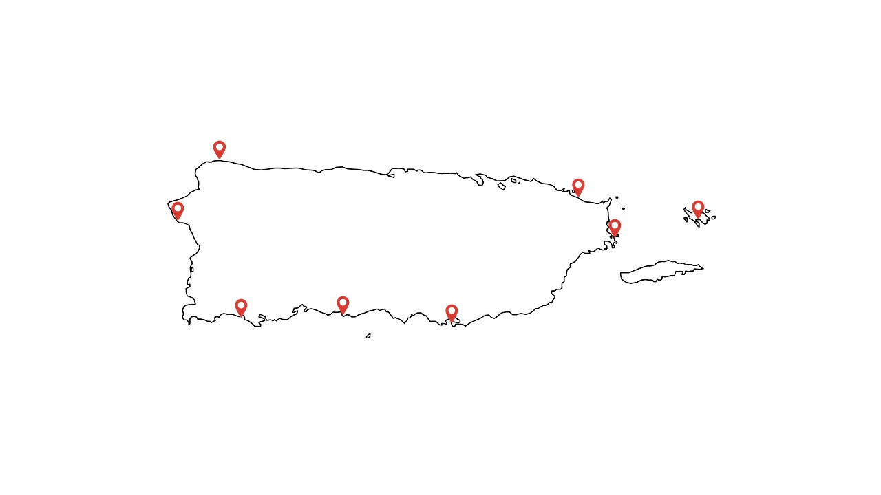

Slide 25
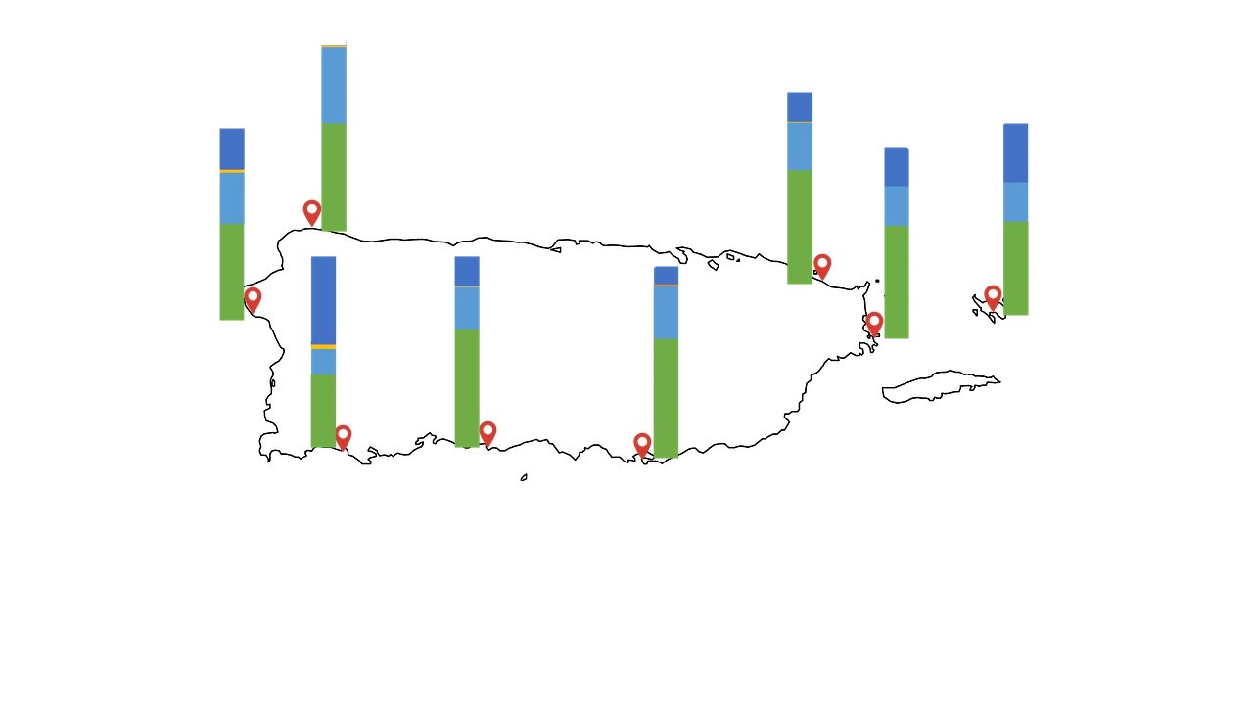
Notes:
Make them smaller

Slide 26
Notes:
Taxonomy by habitat level 4

Slide 27
Notes:
Taxonomy by habitat level 5

Slide 28
Notes:
Taxonomy by habitat level 6

Slide 29
Notes:
Taxonomy by size level 4
Legend colors by group. Yellow & different yellow for the same family.

Slide 30
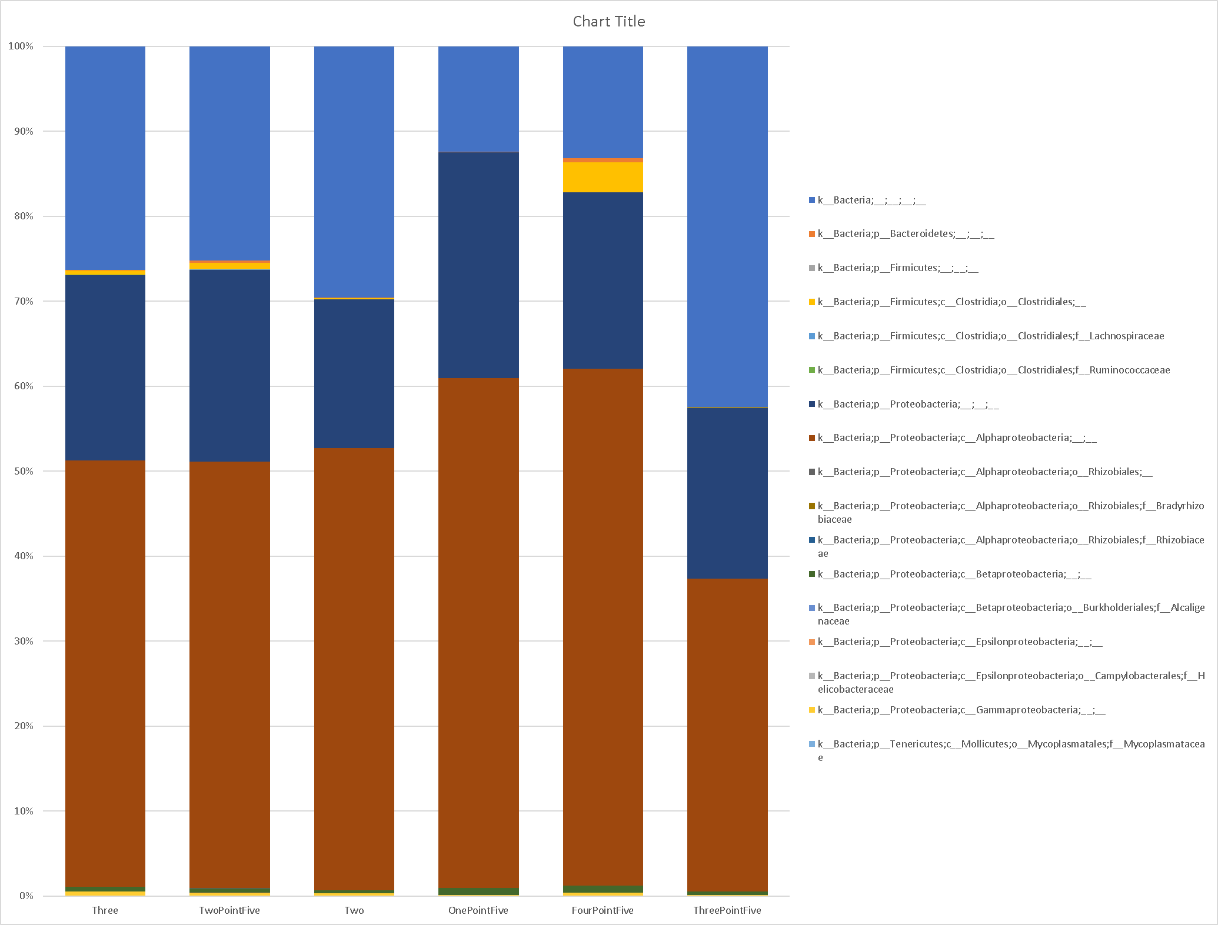
Notes:
Taxonomy by size level 5

Slide 31
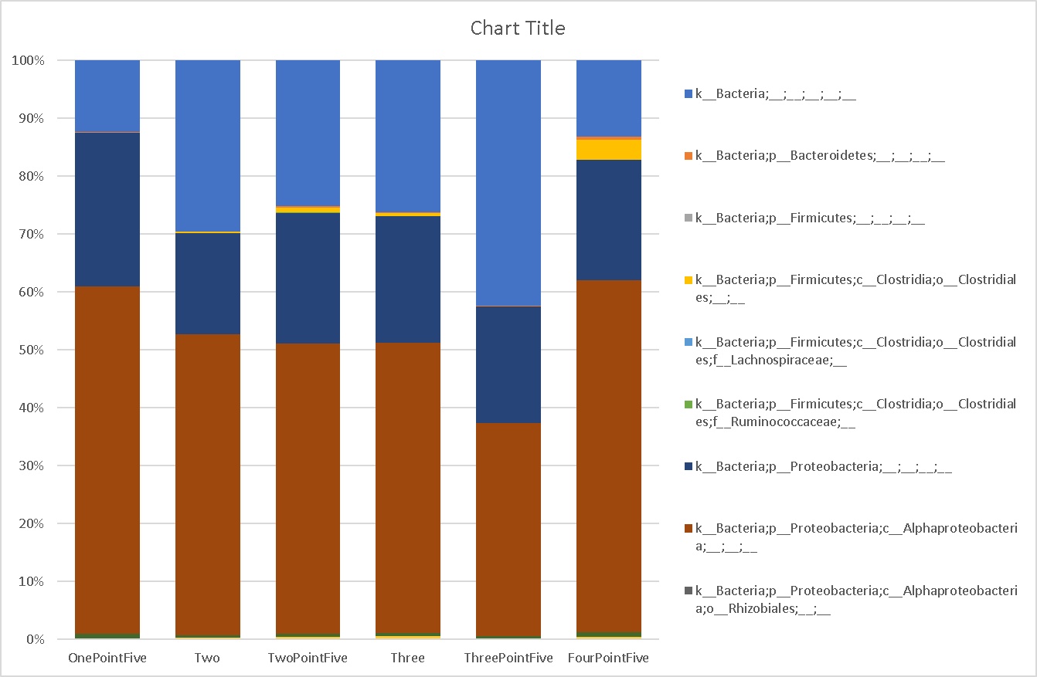
Notes:
Taxonomy by size level 6

Slide 33
Notes:
Taxonomy all samples level 5

Slide 34
Notes:
Taxonomy all samples level 6

Slide 35
Notes:
Taxonomy all samples level 7. Unite this with the phylogenetic tree to see the relationships.

Slide 36
CytoB

Slide 37
PCR Ingredient | PCR Total Reaction
Buffer | 5uL
Pol | .5uL
ddH20 | 15.75uL
DNTPs | .5uL
BSA | 1uL
DNA | 1uL
Primers | 1.25uL
Total | 25uL

Slide 38
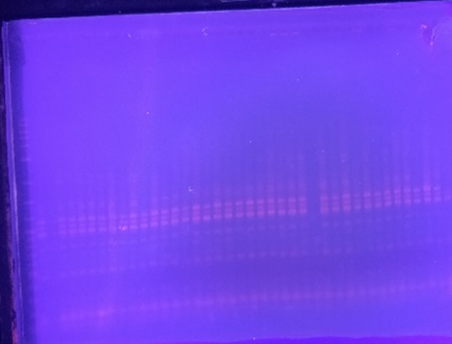
Notes:
Here is an image showing the products of the PCR reactions.

Slide 39
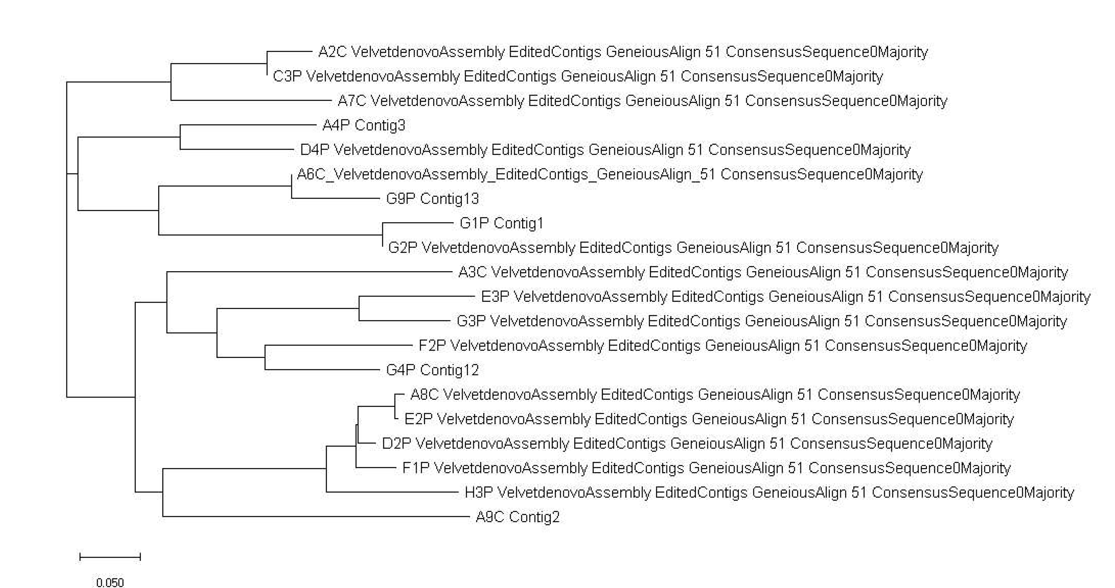
Notes:
Color code by location, size, etc.

Slide 40
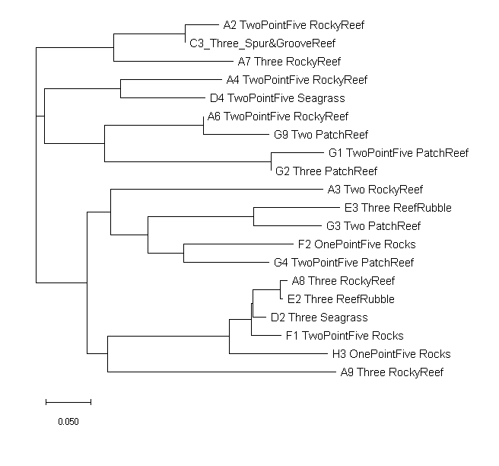







Notes:
Color code by location.
H1: genotype determine microbiome?

